Slide 1
Case Study 14
Race Condition in XV6 Shared Data
Operating Systems | Department of CSE
L Nithish Kumar Goud | 160124733327
G Ishan | 160124733322
Santhosh | 160124733332
Venkat | 160124733340
Chaitanya Bharathi Institute of Technology | Faculty / semester / year: __________
Notes:
This case study examines shared kernel data in xv6 on four CPUs. Team names and roll numbers follow the supplied division document. Faculty, semester, and academic year remain blank for the department to complete. I’ll begin with the race definition, then trace the allocator example.

Slide 2
Case Study 14: Required scope
Problem: study concurrent access to shared kernel data without synchronization.
Analyze how xv6 locks prevent inconsistent updates.
Objectives: understand critical sections, identify shared data, explain mutual exclusion, observe concurrent updates, and explain lock safety.
Motivation: four CPUs share one allocator. Activities: stress, remove/restore four calls, compare. Outcome: explain lock safety. Source: Case Study 14 brief.
02
Notes:
The assignment studies xv6 shared kernel data and its existing locks. The project compares original locking, a temporary four-call removal, and restoration. The motivation is that multiple CPUs can request and release physical pages concurrently. Next I’ll show how two CPUs can interleave the same free-list update.

Slide 3
1. A race condition makes correctness depend on interleaving
Race condition: shared-data correctness depends on how concurrent operations interleave.
In xv6, concurrent kalloc() calls can read the same kmem.freelist head.
Table 1. A stale free-list head can assign page P twice
Step | CPU 0: kalloc() | CPU 1: kalloc()
1 | r0 = freelist = P | r1 = freelist = P
2 | freelist = P->next | freelist = P->next
3 | return P | return P
Source: xv6 kernel/kalloc.c. Illustrative schedule, not a recorded trace.
03
Notes:
A race is a correctness defect whose outcome depends on how concurrent operations interleave. The xv6 example is the allocator: without kmem.lock, CPU 0 and CPU 1 can both read P as the free-list head, both advance the head from the same stale pointer, and both return P. This is a source-level possible schedule, not a trace claimed for any one recorded failure. That stale update can cause memory corruption, allocator failures, or a kernel trap.

Slide 4
2. Race conditions can corrupt data and stop kernel work
A lost head update can make a free page unreachable.
Two allocators may return the same physical page.
Broken links can corrupt memory or trap the kernel.
Damage can spread into unrelated processes and kernel work.
Source: allocator invariant. A timeout alone is not a deadlock diagnosis.
04
Notes:
The allocator invariant requires each free physical page to appear exactly once in the free list and never be returned to two callers at once. Violating that invariant can lose pages, corrupt memory, or crash the kernel. A race and a deadlock describe different problems. Before the proposed fix, I’ll review the existing xv6 locks and their tradeoffs.

Slide 5
Existing System: xv6 protects a global free list
Table 2. Shared kernel structures and their locks
Shared structure | Lock and purpose
Physical-page free list | kmem.lock — serializes kalloc() and kfree()
Process table | p->lock — protects per-process state
PID allocator | pid_lock — coordinates PID assignment
Parent/child state | wait_lock — coordinates wait transitions
Buffer cache | bcache.lock — protects shared metadata
Timer ticks | tickslock — protects the shared tick count
Source: MIT xv6 locking chapter. Per-CPU lists need refill/steal; CAS needs ABA-safe reclamation; neither was tested.
05
Notes:
Standard xv6 uses one global kmem.lock for a single physical-page free list. This is simple and correct but serializes allocators and can make CPUs spin under contention. Per-CPU free lists can reduce that contention but need page refill or stealing logic. A lock-free compare-and-swap path needs safe pointer handling, including ABA mitigation. These alternatives were not implemented or benchmarked. Other shared structures listed here were reviewed at source level only. Now I’ll state the synchronization rule this experiment tests.

Slide 6
3. Proposed Solution: hold kmem.lock for the full update
Keep kmem.lock around each free-list update.
Protect the complete read-and-update sequence.
Use atomic ownership with acquire/release ordering.
Keep the critical section short.
Source: xv6 allocator code. The experiment restores the existing lock.
06
Notes:
The solution preserves the invariant by serializing the complete free-list push or pop. In the tested xv6 revision, acquire and release use atomic operations with acquire and release ordering. The experiment restores the existing lock rather than adding a new one. Next I’ll define synchronization and place spinlocks among the common mechanisms.

Slide 7
4-5. Synchronization coordinates shared access
Synchronization coordinates concurrent operations so shared state stays correct.
A critical section protects dependent reads and writes as one operation.
Types: mutex, spinlock, semaphore, condition variable, reader-writer lock, barrier, atomic.
xv6 uses a spinlock for the allocator; this study tests that lock.
Source: xv6 spinlock.c. Atomic ownership excludes other CPUs.
07
Notes:
Synchronization coordinates concurrent operations so shared state stays correct. A critical section groups dependent reads and writes. Common mechanisms include mutexes, spinlocks, semaphores, condition variables, reader-writer locks, barriers, and atomic operations. The experiment evaluates only xv6’s allocator spinlock. The workflow connects the guest allocation path to the host experiment phases.

Slide 8
Working flow
GUEST ALLOCATION | 4 children × 8 pages × 200 rounds
race_test.c
4 forked workers
sbrk(bytes)
user/ulib.c
sys_sbrk()
kernel/sysproc.c
growproc() → uvmalloc()
kalloc()
kmem.lock
Release path: uvmdealloc() → uvmunmap() → kfree().
HOST C RUNNER | controlled phases and restoration
A: LOCKED
original allocator
B: UNLOCKED
remove four calls
C: RESTORED
restore bytes, rebuild
VERIFY
hash + diff + results.csv
Fresh QEMU boot per attempt; save console output and one result row.
Figure 1. Guest and host workflow. Source: race_test.c and member1_tools.c.
08
Notes:
Implementation diagram based on the checked source and recorded host workflow. Guest growth: user/race_test.c → user/ulib.c sbrk → kernel/sysproc.c sys_sbrk → kernel/proc.c growproc → kernel/vm.c uvmalloc → kernel/kalloc.c kalloc. Shrink reaches uvmdealloc/uvmunmap and kfree. Host phases are controlled by member1_tools.c: baseline with four lock calls present, a deliberate edit of exactly four acquire/release calls, then byte-for-byte restoration and rebuild. atexit(restore) handles normal C process termination; it cannot guarantee recovery after power loss or forced termination. Evidence CSV and raw logs remain separated by dataset. The workflow shows how the guest and host phases connect; next I’ll inspect the source.

Slide 9
6. xv6 holds kmem.lock across each free-list update
/* kalloc(): remove one free page */
acquire(&kmem.lock);
r = kmem.freelist;
if (r) kmem.freelist = r->next;
release(&kmem.lock);
/* kfree(): add one free page */
acquire(&kmem.lock);
r->next = kmem.freelist;
kmem.freelist = r;
release(&kmem.lock);
Figure 2. kalloc() and kfree() update the free list inside kmem.lock. Source: kernel/kalloc.c.
09
Notes:
kernel/kalloc.c declares kmem.freelist and kmem.lock. kalloc acquires the lock before reading the head and advancing it. kfree acquires it before linking a page to the head. kernel/spinlock.c and spinlock.h implement initlock, acquire, release, holding, push_off, and pop_off. Source: https://github.com/mit-pdos/xv6-riscv/blob/f780d7850765d74cbdcd1fff4b822d8829f7c9bd/kernel/kalloc.c and https://github.com/mit-pdos/xv6-riscv/blob/f780d7850765d74cbdcd1fff4b822d8829f7c9bd/kernel/spinlock.c The allocator code identifies the protected section; next I’ll explain the guest test.

Slide 10
7. race_test.c checks concurrent page allocations
The parent forks four workers, waits for all four, then writes one gate token per child.
Each worker requests eight pages, fills a child-specific tag, rereads 32 KiB, then shrinks.
volatile uchar *memory = (volatile uchar *)allocation;
for (int offset = 0; offset < bytes; offset++)
memory[offset] = tag;
Any pipe/fork error or non-zero wait() status makes the run fail.
Source: user/race_test.c; four workers repeat 200 rounds.
10
Notes:
The guest C program uses a pipe as a start gate, forks four children, and only releases them after all workers exist. Each worker repeats 200 rounds of sbrk(8*4096), writes a unique byte tag across the 32 KiB allocation, waits briefly in user space, rereads each byte, then calls sbrk(-bytes). The parent verifies every wait() status. volatile requests fresh reads in this test; it does not synchronize the kernel or prevent aliasing of a physical page. The guest test creates overlapping allocation requests; next I’ll show the host runner.

Slide 11
7. member1_tools.c automates the WSL experiment
Host C helper builds xv6, launches QEMU, records each attempt, and restores kalloc.c.
Its run, package, and replay modes validate, summarize, and replay saved evidence.
PowerShell: wsl -d Ubuntu-24.04
cd ~/xv6-member1
git rev-parse HEAD
make -j4 kernel/kernel fs.img
make qemu CPUS=4
# xv6 shell: echo hello xv6; usertests -q; race_test
Source: member1_tools.c and the saved WSL run sequence.
11
Notes:
member1_tools.c is the host C runner. Its helper functions handle paths, file loading and saving, subprocess execution, checked commands, build recording, result messages, run timing, CSV rows, manifests, package creation, restoration, and replay. In the guest, user/ulib.c sbrk reaches kernel/sysproc.c sys_sbrk, kernel/proc.c growproc, kernel/vm.c uvmalloc or uvmdealloc, then kernel/kalloc.c kalloc or kfree. The command shown is a reproducible WSL sequence; the measured C-runner set was automated through run mode. The host runner automates builds, attempts, and restoration; next I’ll summarize its setup.

Slide 12
Four CPUs and fixed workloads produced two 30-run datasets
Table 3. Recorded environment and run controls
Setting | Recorded configuration
Guest / host | RISC-V xv6 / Ubuntu 24.04 under WSL2
Emulator / compiler | QEMU 8.2.2 / RISC-V GCC 13.3.0
Resources | 4 CPUs; 128 MiB RAM
Workload | 4 children; 8 pages each; 200 rounds
Attempts | 10 per phase; fresh guest per attempt
Limits | 30 s to shell; 60 s after stress command
Source: run logs and both results.csv files; no kernel delay.
12
Notes:
The source revision is f780d7850765d74cbdcd1fff4b822d8829f7c9bd. Environment: Ubuntu 24.04 under WSL2, QEMU 8.2.2, RISC-V GCC 13.3.0, four CPUs, and 128 MiB guest RAM. Every attempt booted a fresh guest. The host used a 30 second shell timeout and 60 seconds after starting the stress test. All attempts reached the shell and started the test. No kernel timing instrumentation was used. With the environment fixed, I’ll show a possible two-CPU interleaving.

Slide 13
8. Removing kmem.lock permits duplicate pages or lost frees
Table 4. Possible kalloc() schedule without kmem.lock
Step | CPU 0 | CPU 1
1 | Read head P
2 |  | Read head P
3 | Set head to P.next
4 |  | Set head to P.next
5 | Return P | Return P
Source: kernel/kalloc.c. A matching kfree() lost-head update can make a page unreachable.
13
Notes:
Without kmem.lock, two CPUs can read the same free-list head P before either advances it, and both may return P. During concurrent frees, CPU 0 may link page A to old head F while CPU 1 links page B to F and overwrites the head with B, losing A. These are source-level possibilities. The logs do not identify an exact internal interleaving. The possible schedule motivates the locked baseline shown next.

Slide 14
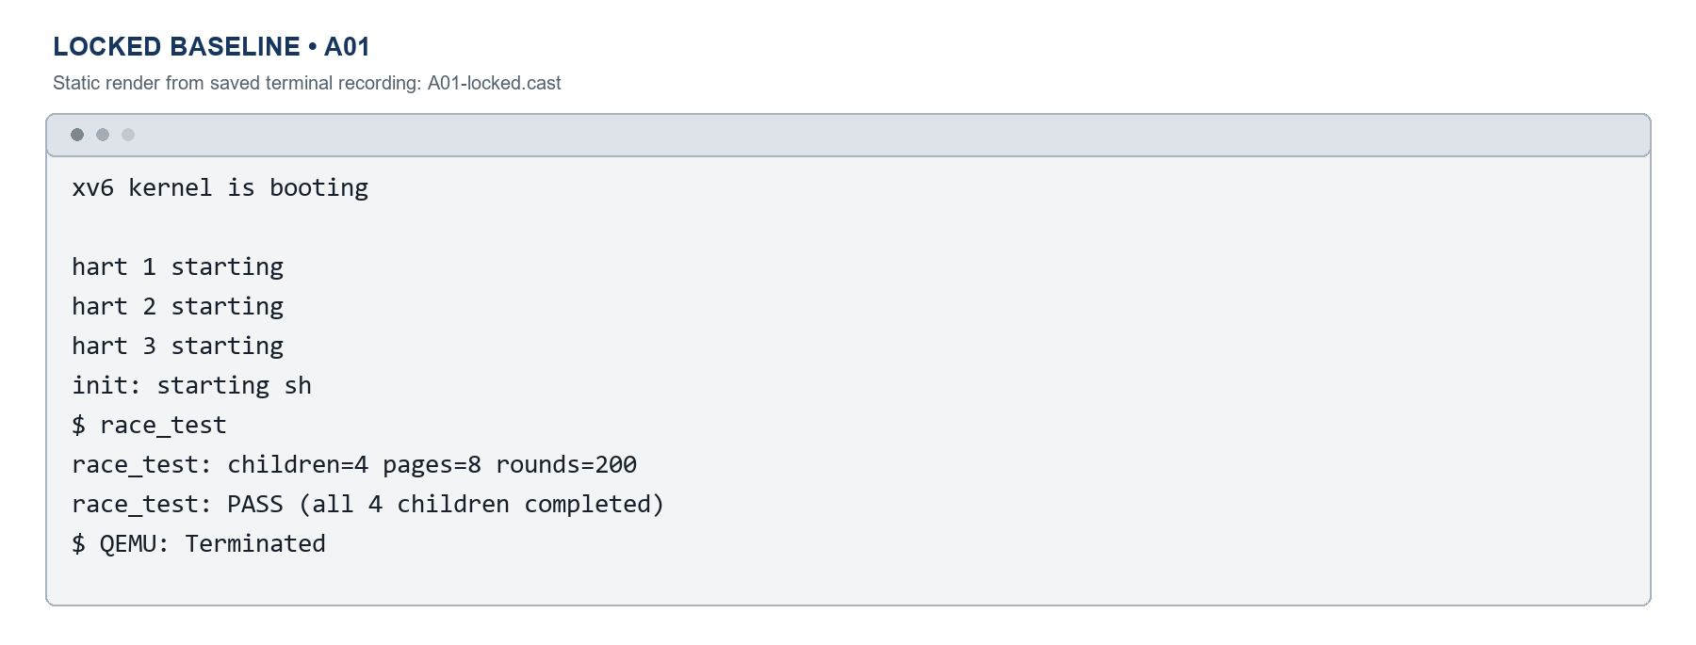
Locked baseline A01 passed with the original allocator
Figure 3. Source: saved original-set A01 terminal recording; locked phase passed 10/10.
14
Notes:
Static terminal still reconstructed from the saved A01 .cast recording. It shows a fresh xv6 boot, the race_test parameters, and PASS. The locked baseline had 10 PASS outcomes in 10 attempts. No video is embedded. The locked baseline passed; now I’ll show the four-call source change.

Slide 15
The unlocked variant removes four allocator lock calls
kalloc(): - acquire(&kmem.lock); + // acquire(&kmem.lock);
- release(&kmem.lock); + // release(&kmem.lock);
kfree(): - acquire(&kmem.lock); + // acquire(&kmem.lock);
- release(&kmem.lock); + // release(&kmem.lock);
Figure 4. Source: temporary kalloc.c diff; four lock calls removed.
15
Notes:
The experimental variant comments out acquire and release in both kalloc() and kfree(), four calls total. The free-list operations and workload stay unchanged. Removing the calls also removes their local interrupt-handling effects when no outer lock is active, so the experiment does not isolate those effects. The source change removes the lock around the full update; next is B02 evidence.

Slide 16
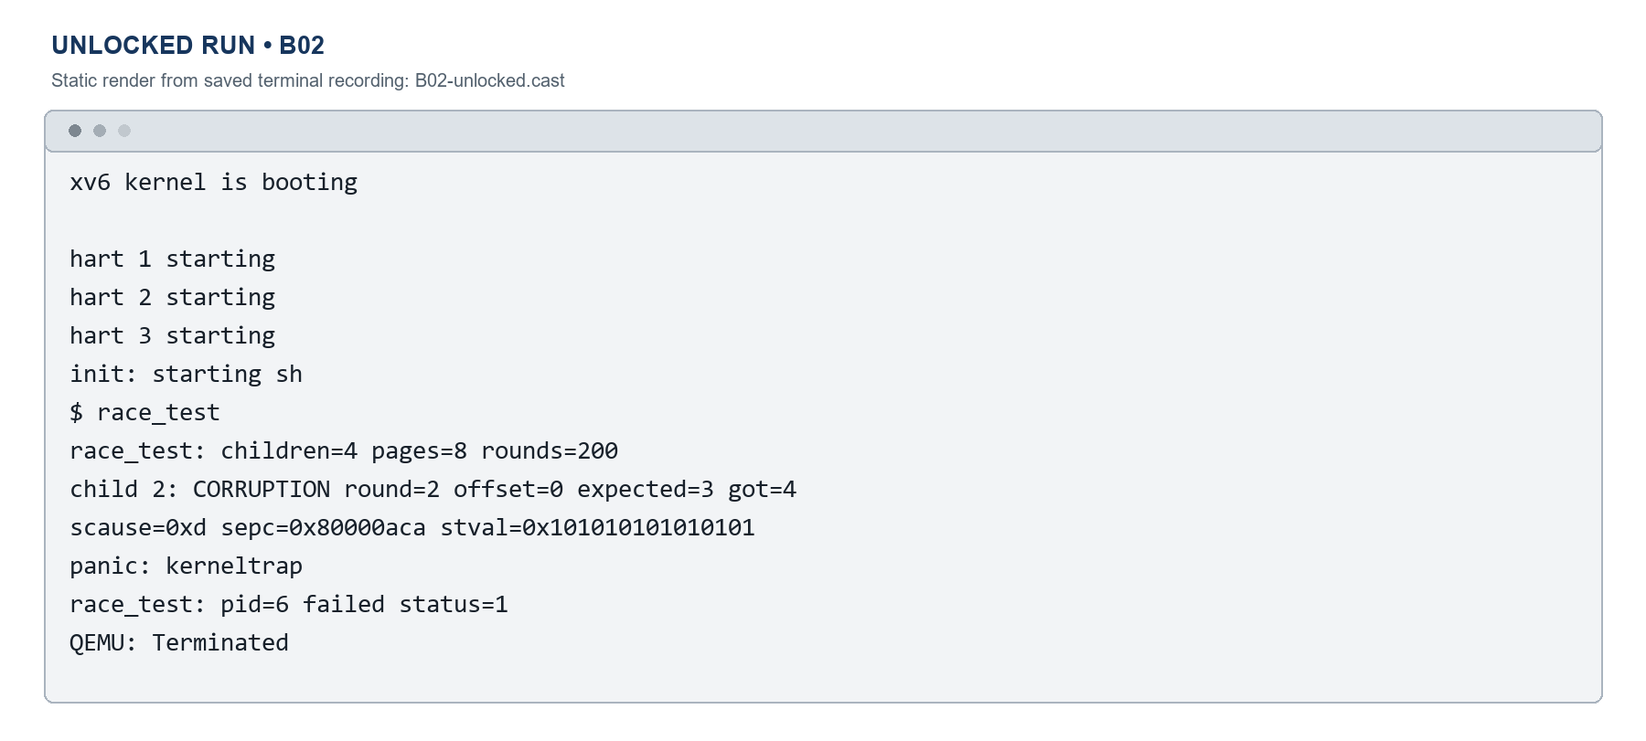
B02 shows corruption followed by kerneltrap
The primary classification is CORRUPTION; the later panic remains visible.
Figure 5. Source: saved original-set B02 recording and results.csv.
16
Notes:
Static terminal still reconstructed from the saved B02 .cast recording. It shows the corruption message followed by kerneltrap. The primary outcome is CORRUPTION under the classifier precedence; the time limit did not expire in this attempt. B02 records corruption followed by a kerneltrap; next I’ll verify restoration.

Slide 17
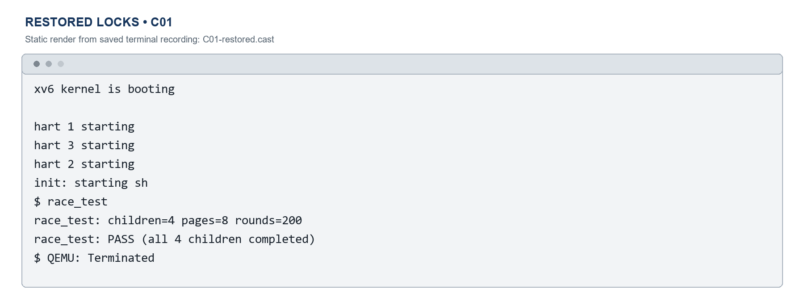
Restoring the allocator and rebuilding returned a passing run
Source hash: verified
Final allocator diff: empty
C01 race_test: PASS
Figure 6. Source: saved C01 recording and restoration checksum; PASS.
17
Notes:
The original allocator bytes were restored, the final allocator diff was empty, and the kernel was rebuilt. Static terminal still reconstructed from saved C01 .cast recording shows PASS. The restored phase had 10 PASS outcomes in 10 attempts. No video is embedded. Restoration returned to the saved allocator; next I’ll compare all attempts.

Slide 18
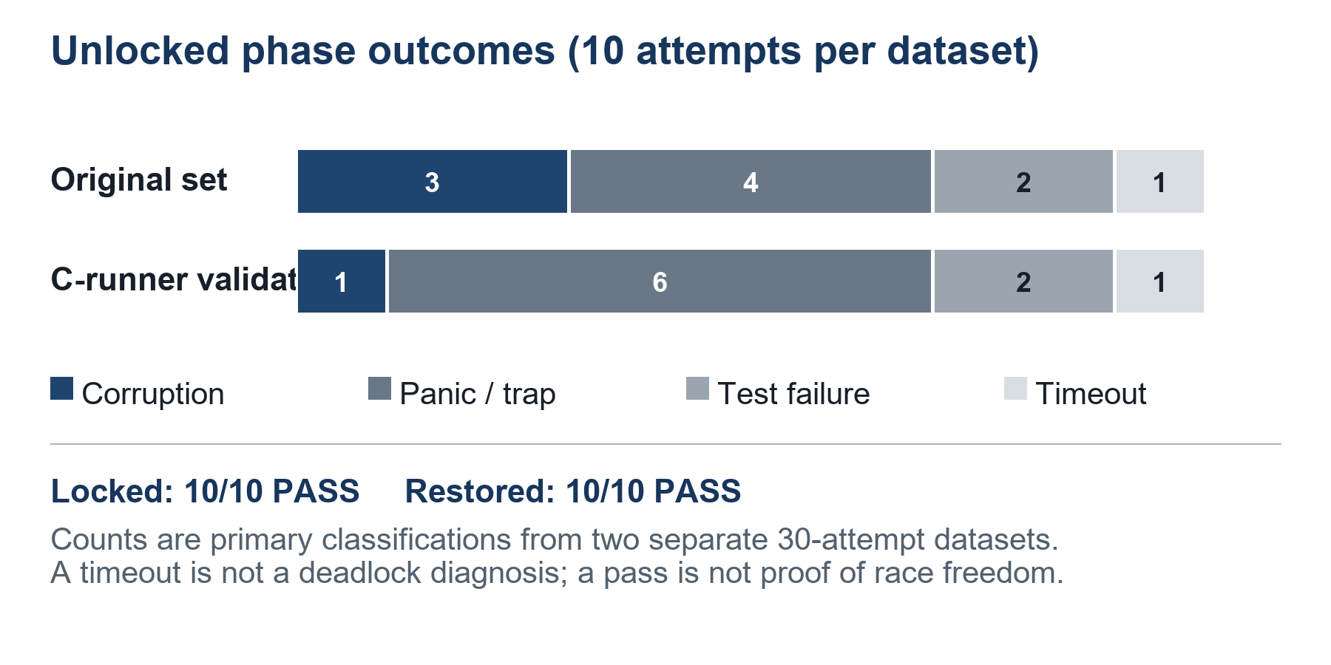
9. Locked and restored phases passed; every unlocked attempt failed
Table 5. Results by phase
Phase | Original | C-runner
Locked | 10/10 PASS | 10/10 PASS
Unlocked | 3C / 4P / 2F / 1T | 1C / 6P / 2F / 1T
Restored | 10/10 PASS | 10/10 PASS
Figure 7. Primary outcomes in two independent unlocked datasets.
Elapsed seconds start at the shell prompt, just before race_test is sent; collection time is included.
Source: both results.csv files, Oct 2026. PASS is not proof; timeout is not deadlock diagnosis.
18
Notes:
The chart compares two separate 30-attempt datasets. The original unlocked phase recorded three corruption outcomes, four panics or traps, two test failures, and one timeout. The C-runner phase recorded one corruption, six panics or traps, two test failures, and one timeout. Both locked and restored phases passed all ten attempts in each dataset. Elapsed time starts when the host sees the xv6 shell prompt, just before it sends race_test, and includes a short output-collection interval. The two datasets show the same locked/restored pattern with different unlocked counts.

Slide 19
10. Conclusion: kmem.lock preserved the free-list invariant
Learning: a lock must cover the full read and update that preserves an invariant.
Finding: all locked and restored attempts passed; unlocked attempts recorded failures.
The same reasoning applies to kernel queues, caches, process data, and shared application state.
Future work: test more CPU counts, detect lost pages, and measure lock contention.
Source: 60 saved attempts across two datasets. Other primitives remain untested.
19
Notes:
The experiment connects a shared-data invariant to mutual exclusion. Locked and restored conditions completed all ten attempts in each dataset, while each unlocked condition produced ten non-PASS outcomes. The conclusion applies to this xv6 revision, QEMU setup, and workload. More CPU counts, allocator-specific lost-page checks, contention measurements, and other shared structures remain future work. The conclusion is limited to this workload; the final slide lists its sources.

Slide 20
References
• xv6 library (MIT PDOS): https://github.com/mit-pdos/xv6-riscv
• MIT xv6 RISC-V book, Locking: https://mit-pdos.github.io/xv6-riscv-book/lock.html
• The Open Group, memory synchronization: https://pubs.opengroup.org/onlinepubs/9699919799/basedefs/V1_chap04.html
• Michael and Scott, Nonblocking algorithms and ABA: https://www.cs.rochester.edu/u/scott/papers/1998_JPDC_nonblocking.pdf
20
Notes:
References: xv6 library (MIT PDOS), https://github.com/mit-pdos/xv6-riscv; MIT xv6 RISC-V book, Locking chapter, https://mit-pdos.github.io/xv6-riscv-book/lock.html; The Open Group memory synchronization specification, https://pubs.opengroup.org/onlinepubs/9699919799/basedefs/V1_chap04.html; Michael and Scott, Nonblocking algorithms and ABA, https://www.cs.rochester.edu/u/scott/papers/1998_JPDC_nonblocking.pdf. These sources ground the case. A useful next study would vary CPU counts and check allocator invariants.

